Slide 1
Project Discussion

Slide 2
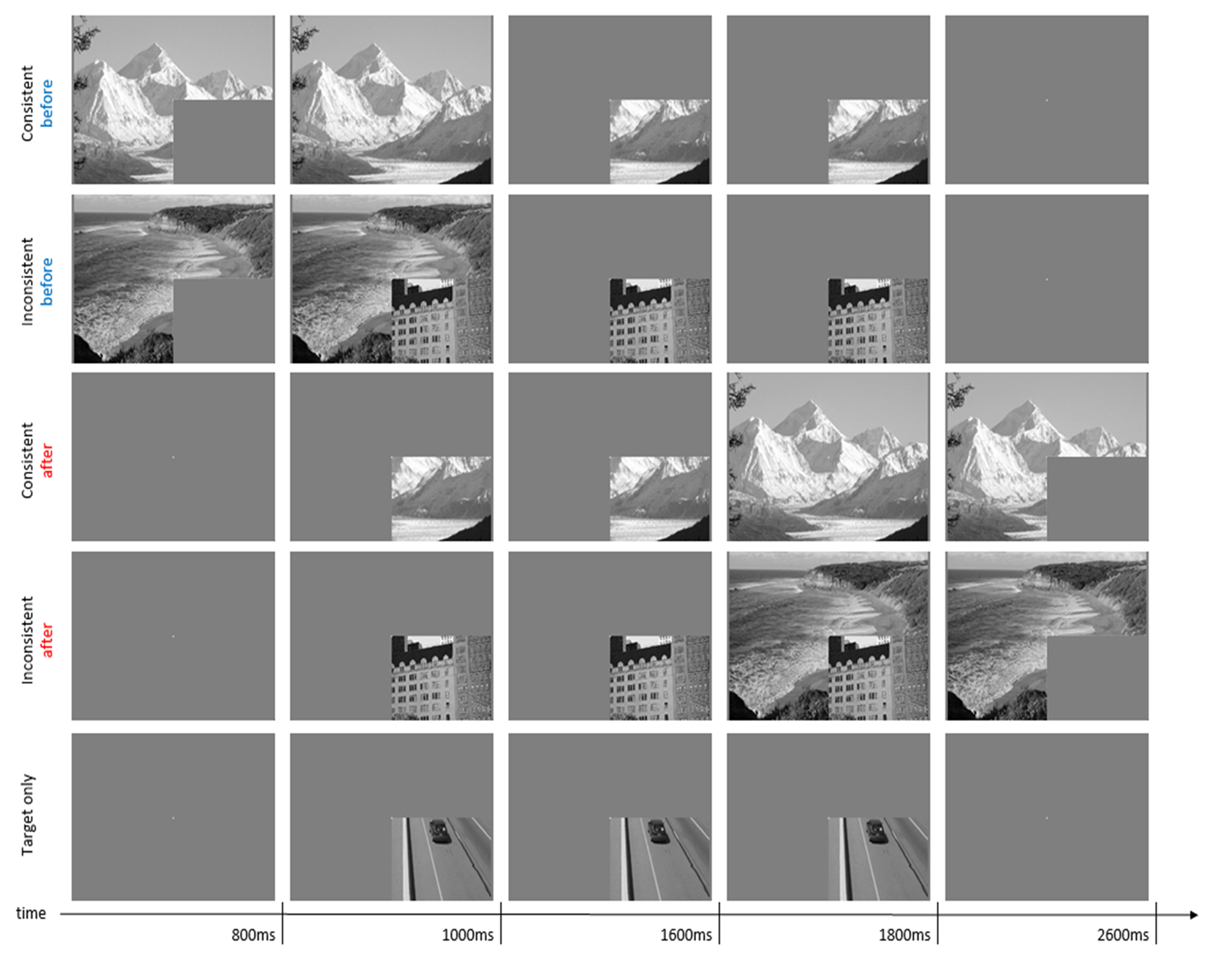
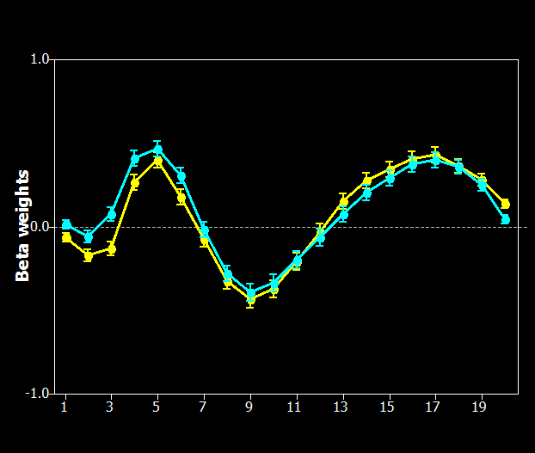
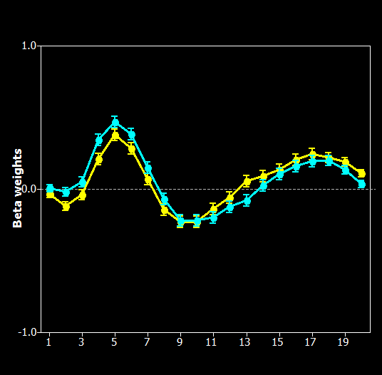

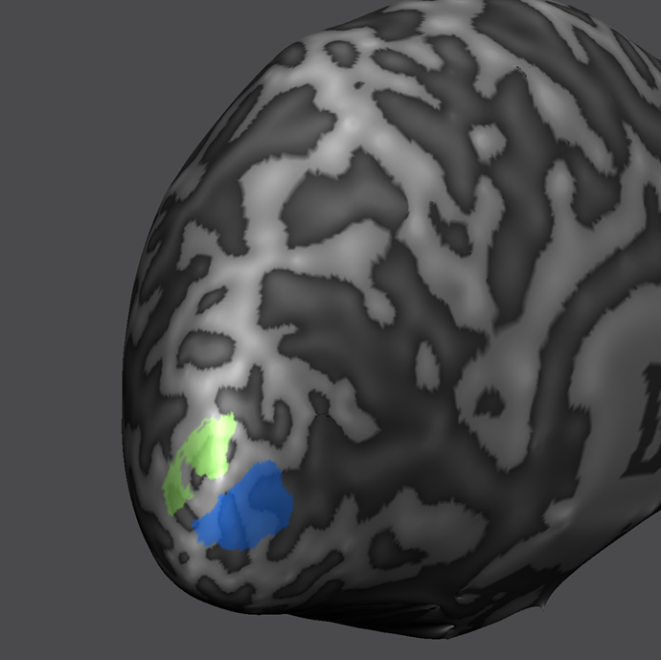
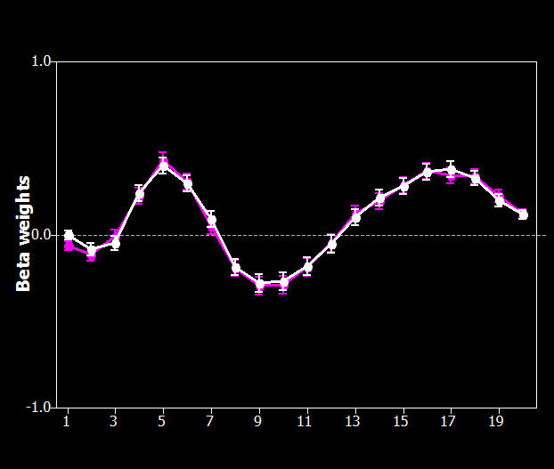
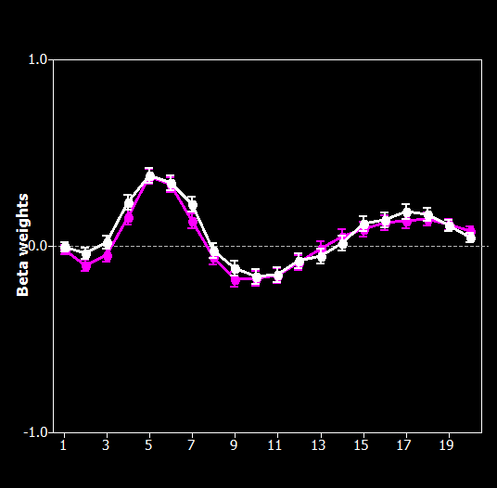

Investigating predictive cortical feedback processing for Expected and surprising scene information (Timing Project)
Research Purpose: Using 3T-fMRI to investigate the modulating effect of consistent and inconsistent contextual information at different stages of cortical processing in V1 and V2, we designed a dynamic paradigm based on the occlusion paradigm (Smith & Muchli, 2010) manipulating feedback and feedforward signals at three different stages.
Current Results (14 subjects):
V1
V2
p = 0.03*
p = 0.018*
-consistent after- vs -inconsistent after
-consistent after- vs -inconsistent after
p = 0.18
p = 0.51
V2
V1

Slide 3
Questions
From the Timing Project.
When the participants finished the scan, I asked them whether they can recognize the difference between the corner image and the contextual image.
Some of them said not, they usually said they paid too much attention to the fixation so that they weaken their perception of the background image.
However, their results still showed inconsistent before has stronger brain activity than consistent after.

Slide 4
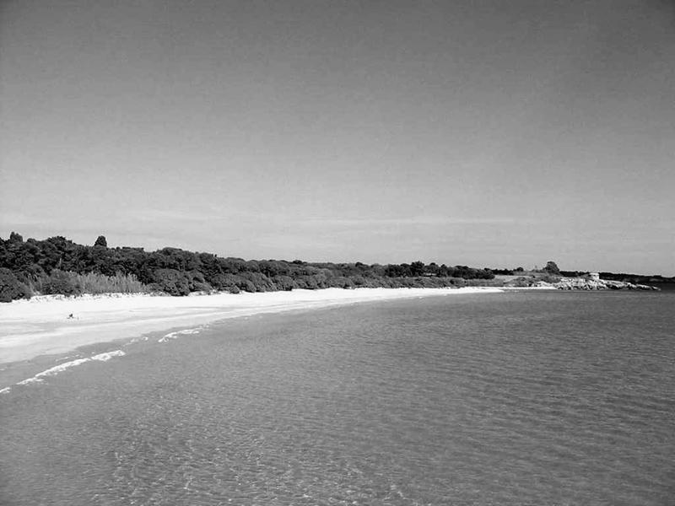
I could imagine when they fixate their eyes on the central cross, the farther contextual information from the cross, the weak perception they may have.
+

Slide 5
Research questions
1. Whether the visual prediction is based on the Proximity or based on Task.
2. Whether contextual information from a far area will be influenced by information from a near area.

Slide 6
New Project
Investigating the predictive cortical feedback processing from near and far contextual information. (3T-fMRI)
Hypothesis:
Contextual information from near surrounding area is fed back more to non-stimulated visual area compared with far area.
Cortical feedback processing of contextual information from far area will be weaken by the inconsistent contextual information from near area.

Slide 7

Near and Far Stimuli Presentation (50%far : 50%near)
A
both contextual information take up 50% 50% (area: blue = green)
Notes:
Clement helped me calculate the area of two contextual information.

Slide 8
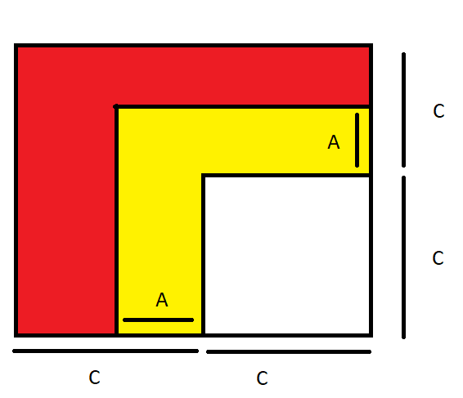
Clement’s Mathtastic work
The red + yellow area is 3*C**2
The yellow area is A**2 + 2*A*C
We want to find A such that:
A**2 + 2*A*C = (3*C**2)/2
<=> 2*A**2 + 4*A*C - 3*C**2 = 0
We can just solve the equation to find one (positive) solution:
A = (-4*C + sqrt(40*C**2))/4
For example, if C = 1, then A = (-4 + sqrt(40))/4 ~ 0.58

Slide 9
Plan A

Slide 10
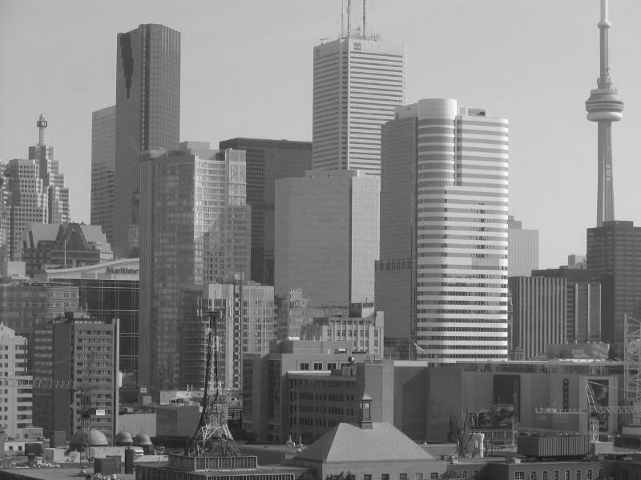
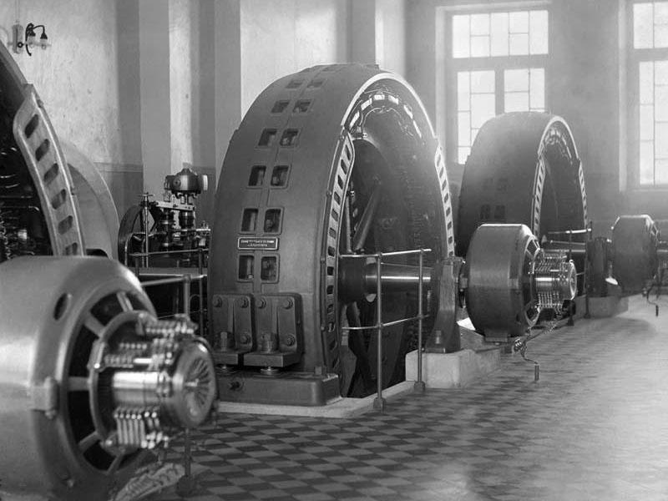
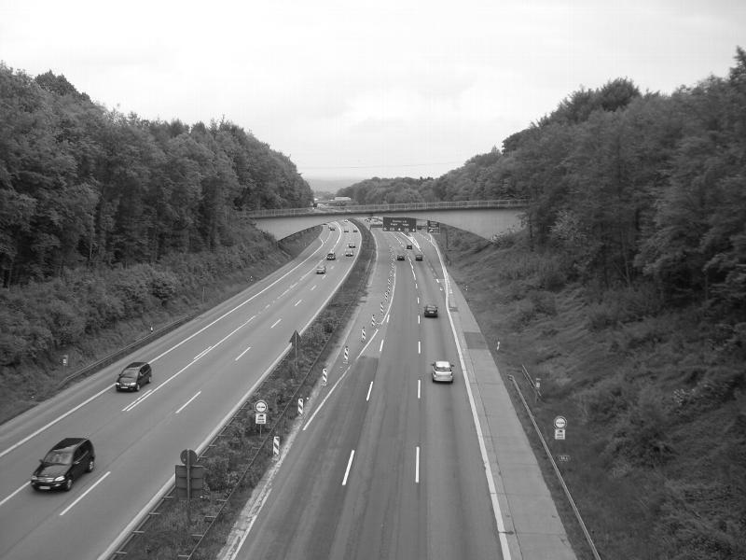
Image stimuli (three images): City, Factory, Road from the database we used before
A
B
C
Reason for choosing these three images:
They don't have the same elements as each other and also have key information appearing in the boundary of the image.
(buildings in city stimuli; machines, big windows, inside walls in factory stimuli; roads, cars, plants in road stimuli)

Slide 11
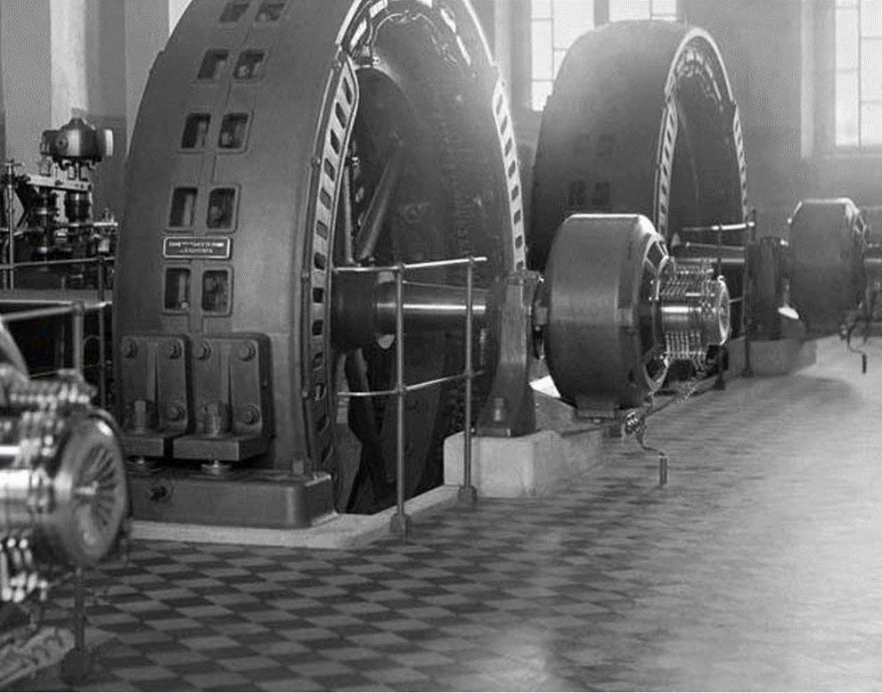
Stimuli example
+

Slide 12
Stimuli example
+

Slide 13
Conditions
1. Full image
2. 50% far : 50% near
City full
Factory full
Road full
City_near+Factory_far
City_near+Road_far
Factory_near+City_far
Factory_near+Road_far
Road_near+City_far
Road_near+City_far
9 Trial types in total

Slide 14
Experimental design
Block design: 6s stimuli(200ms/200ms on/off) + 6s ISI (based on the Yulia’s Mooney Project and Yingying’s visual imagery project)
Duration:
Each run: 12s x 9 stimuli x 5 repetitions + 24s mapping trials= 664s~11 mins
8 experiment runs (40 repetitions for each stimuli) ~ 1 hr 28 mins
(maybe need Two scanning sessions)
Retinotopic run: 13mins
Anatomical run: 10 mins
Total scanning time ~ 2 hours

Slide 15
ROIs
Early Visual Cortex V1, V2, V3

Slide 16
Lucy’s Point
It may depend on the task of our requirements.
If we ask them to imagine including far contextual information, they will do.
Same as the near condition.
So……

Slide 17
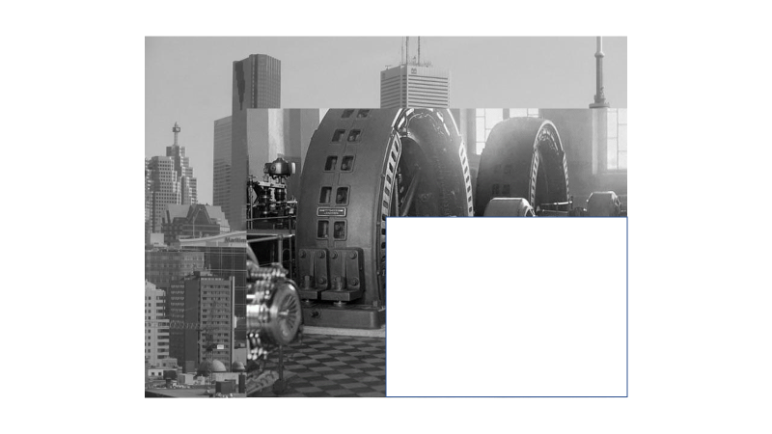
Participants
Group 1: Far
15 healthy Participants
Task:
Fixate their eyes in the central cross
ask them to imagine the occluded parts according to the Far Surrounding contextual information
Press the button when the central cross changes colour.
Or Press the button for recognising image (1:city, 2:factory, 3:road)
Group 1: Near
15 healthy Participants
Task:
Fixate their eyes in the central cross
ask them to imagine the occluded parts according to the Near Surrounding contextual information
Press the button when the central cross changes colour
Or Press the button for recognising image (1:city, 2:factory, 3: road)
Total scanning time: 60 hours

Slide 18
Data analysis
MVPA (linear SVM)

Slide 19
Whole Group
Train/Test
Expected results
Classifier performance %
Single trial
Average block
Classifier performance >33.33%

Slide 20

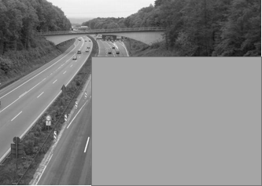
Near Group
Expected results
Example:
Single Trial
Average Block
Train
Test
Classifier performance %
city
road
City_near
Road_near
City_near
Factory_near
Factory_near
Road_near
1. Train: City_full vs Road_full
2. Train: City_full vs Factory_full
3. Train: Factory_full vs Road_full
Test: City_near+ Factory_far vs Road_near+ Factory_far
Test: City_near+ Road_far vs Factory_near+ Road_far
Test: Factory_near + City_far vs Road_near + City_far

Slide 21
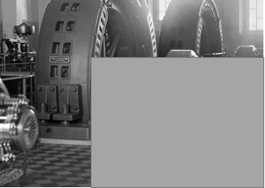
Far Group
Expected results
May be above 50% but the value is less than the near condition
Single Trial
Average Block
Train
Test
Classifier performance %
city
road
City_far
Road_far
City_far
Factory_far
Factory_far
Road_far
1.Train: City_full vs Road_full
2.Train: City_full vs Factory_full
3.Train: Factory_full vs Road_full
Test: City_far + Factory_near vs Road_far+ Factory_near
Test: City_far + Road_near vs Factory_far + Road_near
Test: Factory_far + City_near vs Road_far + City_near

Slide 22
Plan B

Slide 23
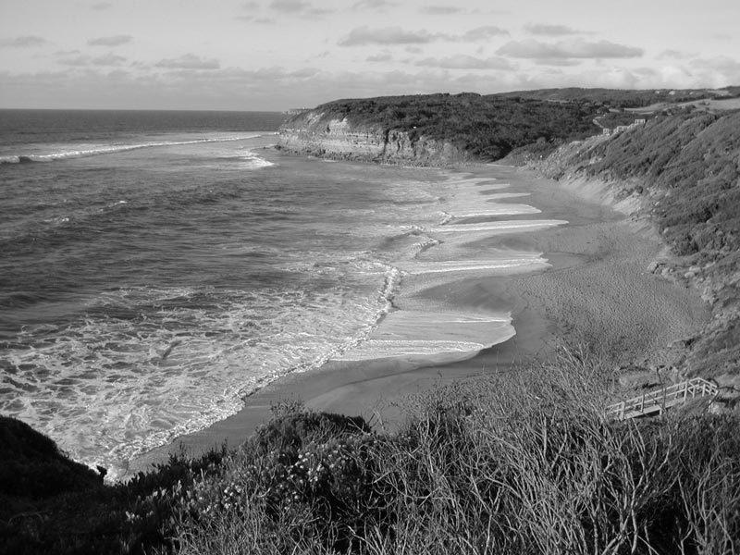
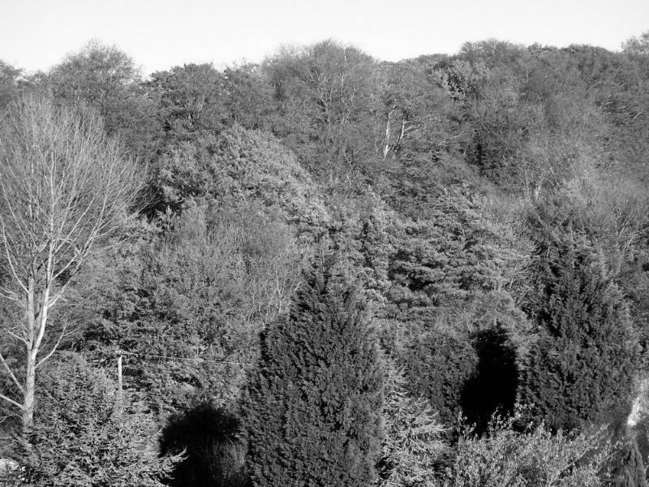
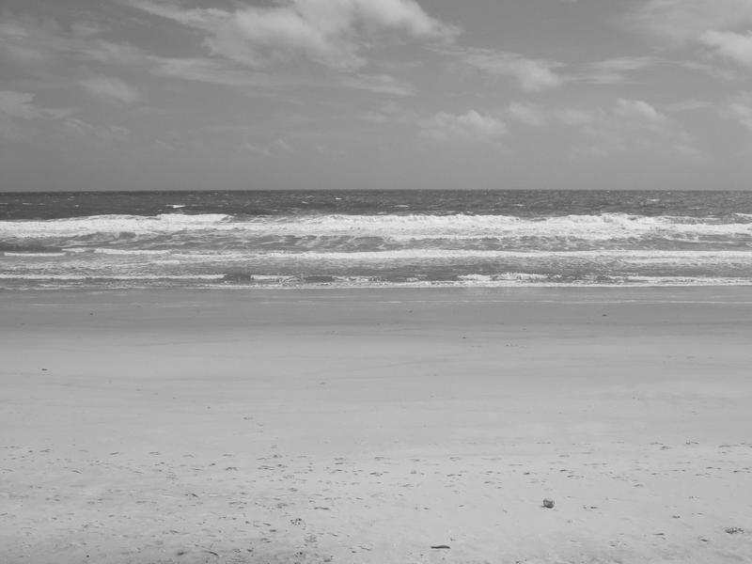
Stimuli
A
B
Noise stimuli
Two Stimuli from City, Factory
Noise Stimuli: images from other two categories with no same elements from A, B (such as beaches, forests)

Slide 24




Conditions
*Random noise stimuli
Full image
City
Factory
Full ¾ image
City
Factory
Near + Noise
City_near + noise
Factory_near + noise
Far + Noise
City_far + noise
Factory_far+noise
8 trial types

Slide 25
Experimental design
Block design: 6s stimuli(200ms/200ms on/off) + 6s ISI (based on the Yulia’s Mooney Project and Yingying’s visual imagery project)
Duration:
Each run: 12s x 8 trial types x 5 repetitions + 24s mapping trials= 504s~8 mins
8 experiment runs (40 times for each stimuli) = 64 mins
Retinotopic run: 13 mins
Anatomical run: 10 mins
Total scanning time ~ 1 hr 40 mins
Scanning order:
Localizer
RUN1
RUN2
RUN3
RUN4
Anatomical run
RUN5
RUN6
RUN7
RUN8
Retinotopic mapping

Slide 26
Participants
Group 1: Far
15 healthy Participants
Task:
Fixate their eyes in the central cross
ask them to imagine the occluded parts according to the Far Surrounding contextual information
Press button when the central cross changes colour
Or Press the button for recognising image (1:city, 2:factory)
Group 1: Near
15 healthy Participants
Task:
Fixate their eyes in the central cross
ask them to imagine the occluded parts according to the Near Surrounding contextual information
Press the button when the central cross changes colour
Or Press the button for recognising image (1:city, 2:factory)
Total scan time:
~ 46 hours

Slide 27
MVPA (linear SVM)

Slide 28
Whole groups (far + near)
Expected results
Train (full image)
Test (3/4 image)
Single Trial
Average Block
Classifier performance %
Train full image
Test ¾ images
Train ¾ images
Test full image
Also, Train ¾ images Test full image

Slide 29
Near Group
Expected results
Example:
Train
Test
Single Trial
Average Block
Classifier performance %
city
road
Train ¾ images Test near+Noise
Train near+noise
Test ¾ images
¾ images
Near+Noise

Slide 30
Near Group
Expected results
Example:
Train
Test
Single Trial
Average Block
Classifier performance %
city
road
Train Full images Test near+Noise
Train near+noise
Test Full images
Full images
Near+Noise

Slide 31
Far Group
Example:
Expected results
Train
Test
Single Trial
Average Block
Classifier performance %
May be above 50% but the value is less than the near condition.
city
road
Train ¾ images Test Far+Noise
Train Far+noise
Test ¾ images
¾ images
Far+Noise

Slide 32
Far Group
Example:
Expected results
Train
Test
Single Trial
Average Block
Classifier performance %
May be above 50% but the value is less than the near condition
city
road
Train Full images Test Far+Noise
Train Far+noise
Test Full images
Full images
Far+Noise

Slide 33
If it is possible…..
We could also categorise noises, then train/test:
Like:
Train: Forest + city vs Forest + factory
Test: Beach + city vs Beach + Factory, city-full vs factory_full, city_3/4 vs factory_3/4
Train: Forest + city vs Beach + factory
Test: Forest + Factory vs Beach + city, city_full vs factory_full, city_3/4 vs factory_3/4

Slide 34
Thanks

